Slide 1
MPU
MBUS100
Introduction to Business
Chapter One
Overview of Economic Systems and Business

Slide 2
Overview of Economic Systems and Business
Learning Objectives:
How do businesses and not-for-profit organizations help create our standard of living?
What are the sectors of the business environment, and how do changes in them influence business decisions?
How do economic growth, full employment, price stability, and inflation indicate a nation’s economic health?
How does the government use monetary policy and fiscal policy to achieve its macroeconomic goals?
What are the basic microeconomic concepts of demand and supply, and how do they establish prices?
What are the four types of market structure?
Which trends are reshaping the business, microeconomic, and macroeconomic environments and competitive arena?

Slide 3
Overview of Economic Systems and Business (Cont.)
Learning Objectives:
Describe the foundational philosophies of capitalism and socialism.
Discuss private property rights and why they are key to economic development.
Discuss the concept of GDP (gross domestic product).
Explain the difference between fiscal and monetary policy.
Discuss the concept of the unemployment rate measurement.
Discuss the concepts of inflation and deflation.
Explain other key terms related to this chapter including: supply; demand; equilibrium price; monopoly; recession; depression.

Slide 4
The Nature of Business
How do businesses and not-for-profit organizations
help create our standard of living?

Slide 5
The Nature of Business
A business is an organization/entity that strives for a profit by providing goods and services desired by its customers.
Profit: what remains after all business expenses have been deducted from sales revenue.
Businesses meet the needs of consumers (customers) by providing medical care, consulting services, and countless other goods and services.

Slide 6
The Nature of Business (Cont.)
A business must combine all four resources effectively to be successful.
Human
Resources
BUSINESS
Informational
Resources
Material
Resources
Financial
Resources

Slide 7
The Nature of Business (Cont.)
Goods are tangible items manufactured by businesses, such as laptops.
Services are intangible offerings of businesses that can’t be held, touched, or stored. For instance: Medical doctors, lawyers, hairstylists, car washes, and airlines all provide services.
Businesses also serve other organizations, such as hospitals, retailers, and governments, by providing machinery, goods for resale, computers, and thousands of other items.

Slide 8
The Nature of Business (Cont.)
Businesses create the goods and services that are the basis of our standard of living.
Definition of Standard of Living: the degree of wealth and material comfort available to a person or community.

Slide 9
Standard of Living
For instance: The States (US) has one of the highest standards of living in the world. However, several countries in Europe, such as Switzerland and Germany, have higher average wages than the US, their standards of living aren’t higher, because prices are so much higher over there.
As a result, the same amount of money buys less in those countries. Specific example is that, in the US, we can buy an “Extra Value Meal” at McDonald’s for less than $5 USD (it will depend where you live and the location of the restaurant), while in another country, a similar meal might cost as much as $10 USD.

Slide 10
Quality of Life
Quality of life refers to the general level of human happiness based on a number of things, such as life expectancy, educational standards, health, sanitation, and leisure time.
Building a high quality of life is a combined effort of businesses, government, and not-for-profit organizations.

Slide 11
Basic Survival Scenario of a Business
Let’s put aside the not-for-profit organizations, a typical business entity is a make-for-profit organization.
To survive (stay alive), a business has to make some money.
In process of trying to make money, risk must be taken by the businesses such that it is the potential to lose time and money or otherwise not be able to accomplish an organization’s goals.

Slide 12
Basic Survival Scenario of a Business (Cont.)
There are a few things in this “survival equation” that keeps this business entity “in business”; otherwise it’s out of business in the long run (usually bankrupt but not always or closed down).
Profit / Loss = Revenue - Costs

Slide 13
Basic Survival Scenario of a Business (Cont.)
Revenue is the money a company receives by providing services or selling goods to customers (consumers).
Costs are expenses for rent, salaries, supplies, transportation, and many other items that a company incurs from creating and selling goods and services. For example, some of the costs incurred by Microsoft in developing its software include expenses for salaries, facilities, and advertising. If Microsoft has money left over after it pays all costs, it has a profit. A company whose costs are greater than revenues shows a loss.

Slide 14
Basic Survival Scenario of a Business (Cont.)
For example, some of the costs incurred by Microsoft in developing its software include expenses for salaries, facilities, and advertising.
If Microsoft has money left over after it pays all costs, it has a profit.
A company whose costs are greater than revenues shows a loss.
A company whose costs are equal to revenues shows a break even.

Slide 15
Not-For-Profit Organizations
Organizations, such as Caritas Macau and Society for the Animal Protection in Macau, are not-for-profit organizations. Their main goals are not aiming to make profits.
These organizations usually involve providing services or products for specific communities.
Another examples of such not-for-profit organizations are Project Management Institute (PMI); it’s a professional organization aimed for promoting or serving Project Management Practitioners. This type of organizations is an industry professional body. One of its main purpose is to promote and provide standards, methodologies for the profession.

Slide 16
Factors of Production: The Building Blocks of Business
Factors of Production: The Building Blocks of Business
To provide goods and services, regardless of whether they operate in the for-profit or not-for-profit sector, organizations require inputs in the form of resources called factors of production.

Slide 17
Factors of Production: The Building Blocks of Business
Factors of Production: The Building Blocks of Business
Four traditional factors of production are common to all productive activity: natural resources, labor (human resources), capital, and entrepreneurship.
Many experts now include knowledge as a fifth factor, acknowledging its key role in business success. By using the factors of production efficiently, a company can produce more goods and services with the same resources.

Slide 18
Factors of Production: The Building Blocks of Business (Cont.)
4 traditional factors of production are common to all productive activity:
Capital;
Entrepreneurship;
Labor (human resources);
Natural resources.
Many experts now say we should include knowledge as a fifth factor.

Slide 19
What is Economics?
Economics is the study (social science) of the production, distribution, and consumption of goods and services. Here goods and services are the outputs. It’s also the study of how wealth is created and distributed.
Resources are the inputs used to produce outputs. Resources may include any or all of the following (to name a few):
Capital, including buildings and equipment
Entrepreneurship
Knowledge
Labor (physical and mental)
Land and other natural resources

Slide 20
Branches of Economics
The 2 main branches of economics are microeconomics and macroeconomics.
Microeconomics is decision made by individual and businesses.
For instance, it examines how the prices of homes affect the number of homes individuals will buy.

Slide 21
Branches of Economics (Cont.)
Macroeconomics is about the economy in general.
For example, macroeconomists study things that make a country's wealth go up and things that make millions of people lose their jobs.
It’s the study of the national economy and the global economy.

Slide 22
Scarcity
Another important principle is that Economics is the study of how humans make decisions in the face of scarcity.
Scarcity is a fact of life. It also means that human wants for goods, services and resources exceed what is available.
Resources, such as labor, tools, land, and raw materials are necessary to produce the goods and services we want, but they exist in limited supply. At any point in time, there is only a finite amount of resources available in this planet.

Slide 23
Scarcity (Cont.)
Economists use the term opportunity cost to indicate what one must give up to obtain what he or she desires.
The idea behind opportunity cost is that the cost of one item is the lost opportunity to do or consume something else.
We should take note of that every society faces the problem of scarcity, where limited resources conflict with unlimited needs and wants.

Slide 24
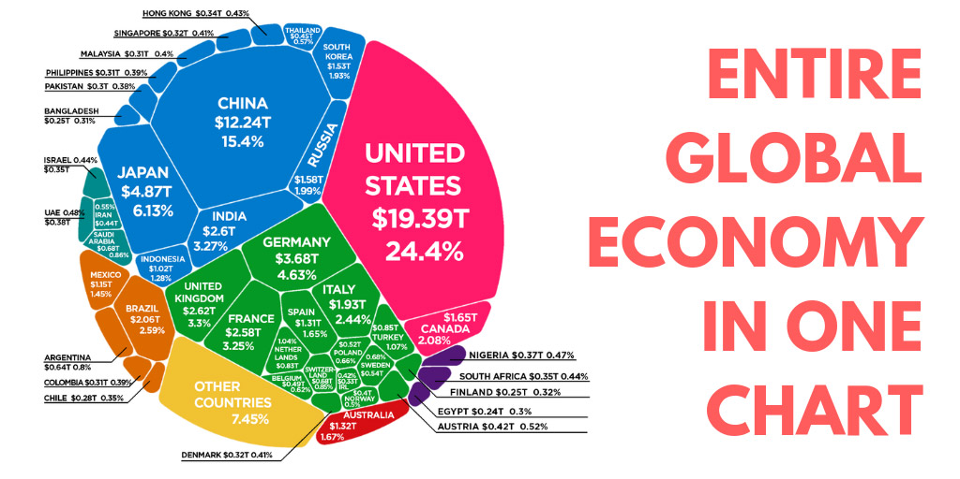
Economy
Economy: The decisions that individuals, business companies, government, and society make and the way in which people deal with the creation and distribution of wealth.

Slide 25
Economic Systems
Economic Systems: An organized way in which a state or nation allocates its resources and apportions of goods and services in the nation.
Another way to define what Economic Systems are the methods used by a society to produce and distribute goods and services.

Slide 26
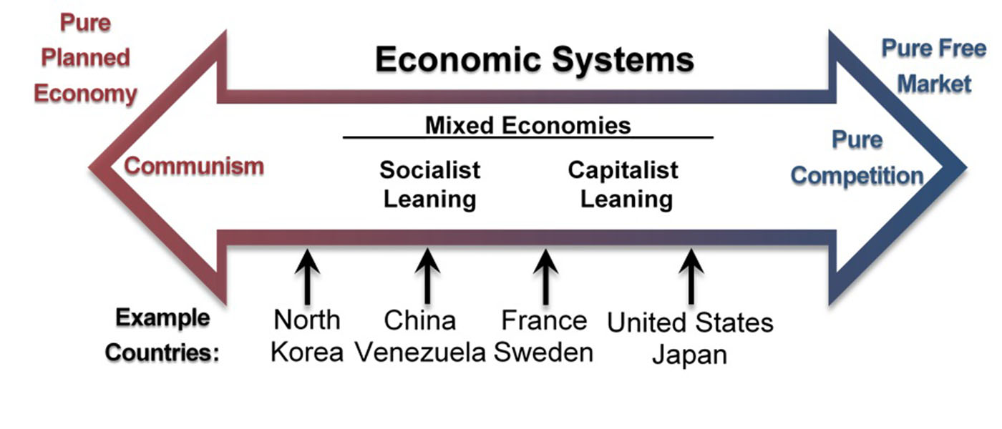
Economic Systems (Cont.)

Slide 27
Economic Systems – Traditional
Basically there are 4 types of economy: Traditional, Centrally Planned (Command), Market and Mixed.
The first is the traditional economy, which is the oldest economic system and is used in parts of Asia, Africa, and South America.
Traditional economies organize their economic affairs the way they have always done (i.e., tradition).

Slide 28
Economic Systems – Traditional (Cont.)
Occupations stay in the family.
Most families are farmers who grow the crops using traditional methods.
What you produce is what you consume. It’s because tradition drives the way of life, there is little economic progress or development.

Slide 29
Economic Systems – Centrally Planned
In a command economy, economic effort is devoted to goals passed down from a ruler or ruling class.
For example, in ancient Egypt, a large part of economic life was devoted to building pyramids for the pharaohs.

Slide 30
Economic Systems – Centrally Planned (Cont.)
In a command economy, the government decides what goods and services will be produced and what prices it will charge for them.
The government decides what methods of production to use and sets wages for workers.
Currently, Cuba and North Korea have command economies.

Slide 31
Economic Systems – Market
Market economies have a very decentralized structure.
A market is an institution that brings together buyers and sellers of goods or services, who may be either individuals or businesses.
In a market economy, decision-making is decentralized. Market economies are based on private enterprises.
Market forces, not governments, determine economic decisions.

Slide 32
Economic Systems – Market (Cont.)
Businesses supply goods and services based on demand. (In a command economy, by contrast, the government owns resources and businesses.)
Supply of goods and services depends on what the demands.
A person’s income is based on his or her ability to convert resources (especially labor) into something that society values. The more society values the person’s output, the higher the income

Slide 33
Supply and Demand in Economics
The Basics of Supply and Demand:
We have mentioned supply of goods and services, let’s see some basics about what Supply and Demand mean in Economics.
The supply of a particular product is the quantity of the product that producers (companies) are willing to sell at each of various prices. Producers are rational people, so we would expect them to offer more of a product for sale at higher prices and to offer less of the product at lower prices.

Slide 34
Supply and Demand in Economics (Cont.)
The Basics of Supply and Demand:
The demand of a particular product is the quantity that buyers (consumers) are willing to purchase at each of various prices. Buyers are rational people as well, so we would expect them, as a group, to buy more of a product for sale at lower price and to buy less of the product at higher price.
Remember the assumption is that both buyers and producers are rational.

Slide 35
Supply and Demand in Economics (Cont.)
The Basics of Supply and Demand:
About what Economists call Equilibrium or Market Price, whenever supply and demand are in balance, or in equilibrium, the supply curve and demand curve intersect at a point which identifies as such a price.
There’s always one certain price at which the demanded quantity of a product is exactly equal to the quantity of that product produced.

Slide 36
Supply and Demand in Economics (Cont.)
The Basics of Supply and Demand:
People are willing to buy less of a product when prices rise and more a product when prices fall.
Using the above logic, we can construct a demand curve that shows the quantity of an apple that will be demanded at different prices.

Slide 37
Supply and Demand in Economics (Cont.)
The Basics of Supply and Demand:
Businesses are more willing to sell of a product when prices rise and less willing to sell a product when prices fall.
Using the above logic, we can construct a supply curve that shows the quantity of an apple that will be supplied at different prices.

Slide 38
Supply and Demand in Economics (Cont.)
The Basics of Supply and Demand: Supply Curve and Demand Curve – “The Equilibrium Price” is the intersection of supply and demand curves, and in this example, the price is at $0.60 and quantity of 2000 pounds

Slide 39
Economic Systems – Mixed
A mixed market economy relies on both markets and the government to allocate resources.
In practice, most economies are mixed, with a leaning towards either free market or socialistic principles, rather than being purely one or the other.

Slide 40
Economic Systems – Mixed (Cont.)
Some previously communist economies, such as those of Eastern Europe and China, are becoming more mixed as they adopt more capitalistic characteristics and convert businesses previously owned by the government to private ownership through a process called privatization.
By contrast, Venezuela is a country that has moved increasingly towards socialism, taking control of industries such as oil and media through a process called nationalization.

Slide 41
4 Types of Competition
Economists have identified four types of competition—perfect competition, monopolistic competition, oligopoly, and monopoly.
Perfect competition: It exists when there are many consumers buying a standardized product from numerous small businesses. Because no seller is big enough or influential enough to affect price, sellers and buyers accept the going price.

Slide 42
4 Types of Competition (Cont.)
Monopolistic competition: we still have many sellers (as we had under perfect competition). Now, however, they don’t sell identical products. Instead, they sell differentiated products—products that differ somewhat, or are perceived to differ, even though they serve a similar purpose.
Products can be differentiated in a number of ways, including quality, style, convenience, location, and brand name. For instance, some people prefer Coke over Pepsi, even though the two products are quite similar. Companies have only limited control over price.

Slide 43
4 Types of Competition (Cont.)
Oligopoly : It means few sellers. In an oligopolistic market, each seller supplies a large portion of all the products sold in the marketplace.
In addition, because the cost of starting a business in an oligopolistic industry is usually high, the number of firms entering it is low.
For instance, companies in oligopolistic industries include such large-scale enterprises as automobile companies and airlines. As large firms supplying a sizable portion of a market, these companies have some control over the prices they charge.

Slide 44
4 Types of Competition (Cont.)
Monopoly: In terms of the number of sellers and degree of competition, a monopoly lies at the opposite end of the spectrum from perfect competition. There’s only one seller in the market.
The market could be a geographical area, such as a city or a regional area, and doesn’t necessarily have to be an entire country.
Without competition, in other words, it enjoyed a monopolistic position in regard to pricing.

Slide 45
4 Types of Competition (Cont.)
Natural monopolies include public utilities, such as electricity and gas suppliers. Such enterprises require huge investments, and it would be inefficient to duplicate the products that they provide. They inhibit competition, but they’re legal because they’re important to society. In exchange for the right to conduct business without competition, they’re regulated.
A legal monopoly arises when a company receives a patent giving it exclusive use of an invented product or process. Patents are issued for a limited time, generally twenty years.

Slide 46
How We Measure the Health of the Economy
You need to understand the nature of the economy your firm is operating in and the terminology that we use to describe it.
Furthermore, you need to have some ideas of where the economy is heading, and it’s also important to know about the government’s role in influencing economy’s direction.
First, we will introduce “Economic Goals”. The world’s economies share three main goals:
Growth
High employment
Price stability

Slide 47
Economic Growth
One way in which economists measure the performance of an economy is by looking at a widely used measure of total output called the gross domestic product (GDP).
The GDP is defined as the market value of all goods and services produced by the economy in a given year. The GDP includes only those goods and services produced domestically; goods produced outside the country are excluded. The GDP also includes only those goods and services that are produced for the final user; intermediate products are excluded.

Slide 48
Economic Growth (Cont.)
For example, the silicon chip that goes into a computer (an intermediate product) would not count directly because it is included when the finished computer is counted.
By itself, the GDP doesn’t necessarily tell us much about the direction of the economy. But change in the GDP does.
If the GDP (after adjusting for inflation, which will be discussed later) goes up, the economy is growing. If it goes down, the economy is contracting.
.

Slide 49
Economic Growth (Cont.)
The Business Cycle ( Economic Cycles)
The economic ups and downs resulting from expansion and contraction constitute the business cycle. A typical cycle runs from three to five years but could last much longer. Sometimes Economists call them Economic Cycles.
Though typically irregular, a cycle can be divided into four general phases of prosperity, recession, depression (which the cycle generally skips), and recovery (will be shown in the next 2 slides):
.

Slide 50
Economic Growth (Cont.)
The Business Cycle (Cont.)
During prosperity, the economy expands, unemployment is low, in- comes rise, and consumers buy more products. Businesses respond by increasing production and offering new and better products.
Eventually, however, things slow down. GDP decreases, unemployment rises, and because people have less money to spend, business revenues decline. This slowdown in economic activity is called a recession.
Economists often say that we’re entering a recession when GDP goes down for two consecutive quarters.

Slide 51
Economic Growth (Cont.)
The Business Cycle (Cont.)
Generally, a recession is followed by a recovery in which the economy starts growing again.
If, however, a recession lasts a long time (perhaps a decade or so), while unemployment remains very high and production is severely curtailed, the economy could sink into a depression.
Unlike for the term recession, economists have not agreed on a uniform standard for what constitutes a depression, though they are generally characterized by their duration.

Slide 52
Economic Growth (Cont.)
The Business Cycle (Cont.)
Economic expansion is the situation that occurs when an economy is growing and people are spending more money; their purchases stimulate the production of goods and services, which in turn stimulates employment.
Economic contraction is a slowdown of the economy characterized by a decline in spending and during which businesses cut back on production and lay off workers.

Slide 53
Full Employment
In principle, full employment occurs when everyone who wants to work has a job.
In practice, we say that we have full employment when about 95 percent of those wanting to work are employed.
We use unemployment rate as an indicator to see if the economy is at full employment or not.

Slide 54
Full Employment (Cont.)
unemployment rate: the percentage of the labor force that’s unemployed and actively seeking work. The unemployment rate is an important measure of economic health. In other words, unemployment is the condition in which a percentage of the population wants to work but is unable to find jobs.
It goes up during recessionary periods because companies are reluctant to hire workers when demand for goods and services is low.
Conversely, it goes down when the economy is expanding and there is high demand for products and workers to supply them.

Slide 55
Price Stability
Price stability occurs when the average of the prices for goods and services either doesn’t change or changes very little.
Rapidly rising prices are troublesome for both individuals and businesses.

Slide 56
Price Stability (Cont.)
For individuals, rising prices mean people have to pay more for the things they need.
For businesses, rising prices mean higher costs, and, at least in the short run, businesses might have trouble passing on higher costs to consumers.
When the overall price level goes up, we have inflation. When the price level goes down (which rarely happens), we have deflation.

Slide 57
Inflation
The most widely publicized measure of inflation is the consumer price index (CPI).
The CPI measures the rate of inflation by determining price changes of a hypothetical basket of goods, such as food, housing, clothing, medical care, appliances, automobiles, and so forth, bought by a typical household.

Slide 58
Economic Forecasting
What if we want to get a sense of where it’s headed in the future? To a certain extent, we can forecast future economic trends by analyzing several leading economic indicators.
An economic indicator is a statistic that provides valuable information about the economy.
In general we have 2 types of Economic Indicators: they are Lagging Indicators and Leading Indicators.

Slide 59
Lagging Indicators VS. Leading Indicators
Statistics that report the status of the economy a few months in the past are called lagging economic indicators. One such indicator is average length of unemployment.
Indicators that predict the status of the economy three to twelve months into the future are called leading economic indicators. If such an indicator rises, the economy is more likely to expand in the coming year.
There’re indicators from various sectors of the economy— labor, manufacturing, and housing.

Slide 60
Government’s Role in Managing the Economy
Monetary policy is exercised by government, which is empowered to take various actions that decrease or increase the money supply and raise or lower short-term interest rates, making it harder or easier to borrow money.
Fiscal policy relies on the government’s powers of spending and taxation. Both taxation and government spending can be used to reduce or increase the total supply of money in the economy—the total amount, in other words, that businesses and consumers have to spend.

Slide 61
Budget Surplus VS. Budget Deficit
If, in any given year, the government takes in more money (through taxes) than it spends on goods and services (for things such as defense, transportation, and social services), the result is a budget surplus.
If, on the other hand, the government spends more than it takes in, we have a budget deficit.

Slide 62
How do we evaluate our nation’s economy
Unit of Measure | Description
Trade Balance | The difference between nation’s exports and imports. If the balance is negative, it’s called trade deficit, and generally viewed as unhealthy for the economy. If the balance is positive, it’s called trade surplus.
Per capita income | Indicates the income level of “average” citizens. Useful in determining how much “average” consumers spend and how much money the citizens are earning.
Worker Productivity | The amount of goods and services produced for each hour worked.

